Slide 1
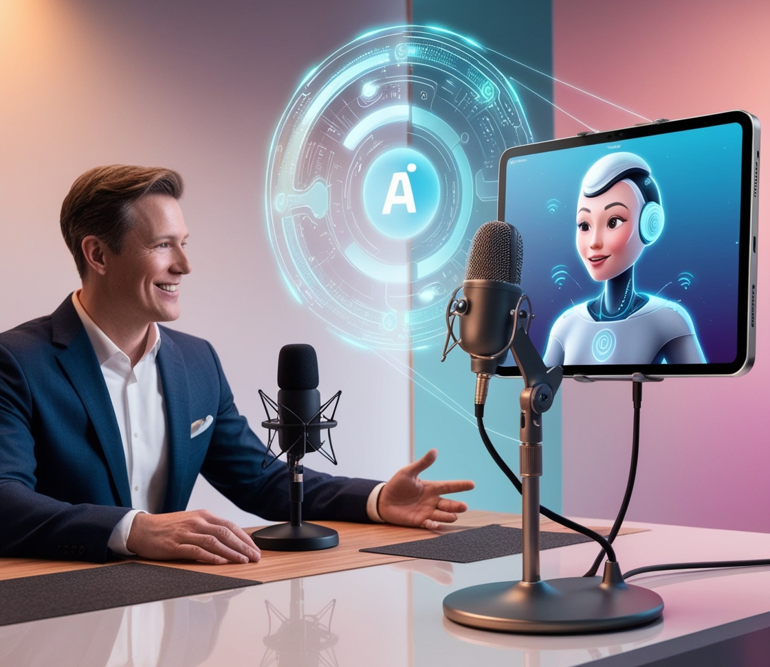

PodVerse
100% Presentation
GROUP MEMBERS
SP22-BCS-079 Rabeea Chughtai
SP22-BCS-087 Sadia Imran
SUPERVISOR
Ms. Saadia Maqbool
Department of Computer Science

Slide 2
Introduction
/02
PodVerse is an AI-driven podcasting platform designed to simplify the podcast production process for content creators, entrepreneurs, and small businesses.
It eliminates technical barriers like complex editing, guest acquisition, and high production costs.

Slide 3
Scope
/03
Enables AI-based voice cloning, speaker customization, and guest interaction.
Supports knowledge upload and smart retrieval using RAG for accurate responses.
Allows users to create, edit, and publish audio/video podcasts with avatars.
Includes chatbots, messaging, feedback, analytics, and admin management tools

Slide 4





/04
MODULES
01
User Authentication & Profile Management
Enables secure account creation, login, password recovery, profile customization, and activity tracking for a personalized experience.
02
Voice Cloning
Allows users to record, upload, preview, and clone voices, with access to voice library for enhanced customization.
03
Knowledge Base Setup
Enables data uploads, processing, retrieve accurate podcast information from structured data.
04
RAG Retrieval
Enhances AI accuracy by retrieving and ranking knowledge base information to provide fact-based, quality responses.

Slide 5


/05
MODULES
05
AI Speaker Customization
Empowers users to personalize AI speakers with names, voices, and avatars.
06
Podcast Audio Creation
Provides tools for recording, editing, and exporting podcast audio in MP3/WAV.
07
AI Host
Manages podcast flow, introduces topics, and summarizes episodes.
08
AI Guest
Responds dynamically to user queries, adding depth to conversations.
09
Podcast Video Creation & Publishing
Transforms audio podcasts into engaging video content with avatars, templates, split-screen layouts, and publishing.

Slide 6

/06
MODULES
10
Subscription & Payment
Manages user subscriptions, payments, renewals, and secure transactions for premium content access.
11
FAQs Chatbot
Offers instant support through an AI chatbot for user queries.
12
Audience Engagement
Enhances interaction through notifications, trending content highlights, podcast summaries, and a communication platform.
13
Admin Panel & Analytics
Provides administrative tools for user management, content moderation, subscription handling, and podcast performance analytics.

Slide 7
Design Methodology
/07
Object-Oriented Design was chosen for:
  Modularity & Reusability – Easy to manage and scale components
  Efficient Testing – Debug individual parts with less effort
  Team Collaboration – Multiple developers can work in parallel
  Real-World Mapping – Structure reflects actual podcasting elements

Slide 8
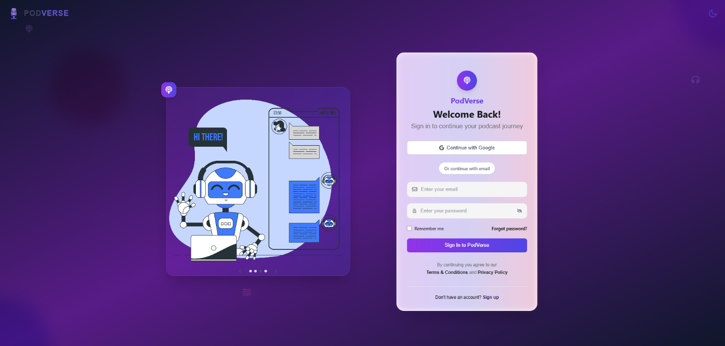
User Interface
/08
reallyygreatsite.com

Slide 9
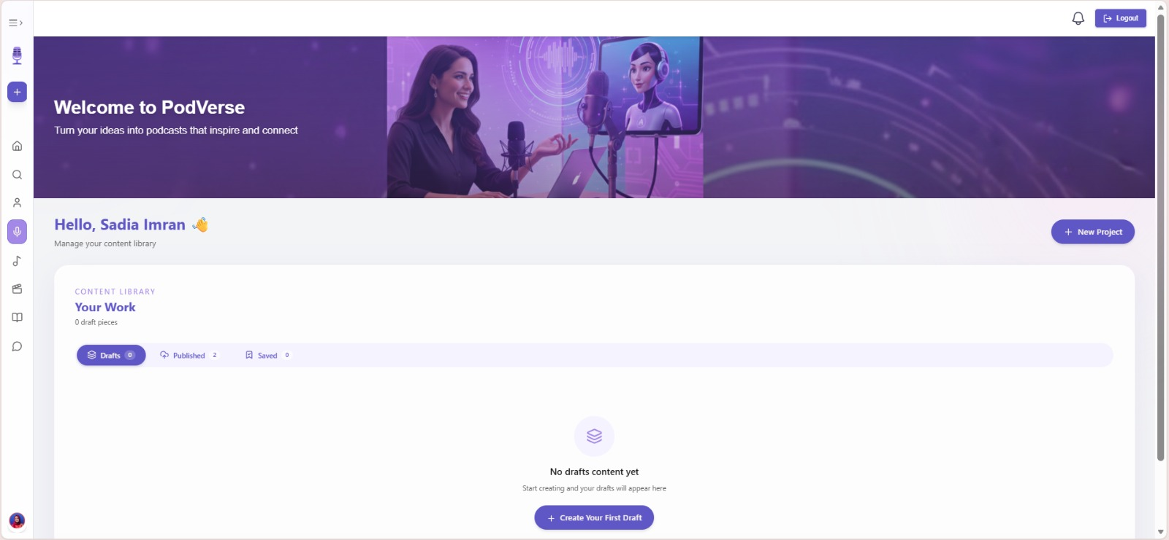
User Interface
/09
reallyygreatsite.com

Slide 10
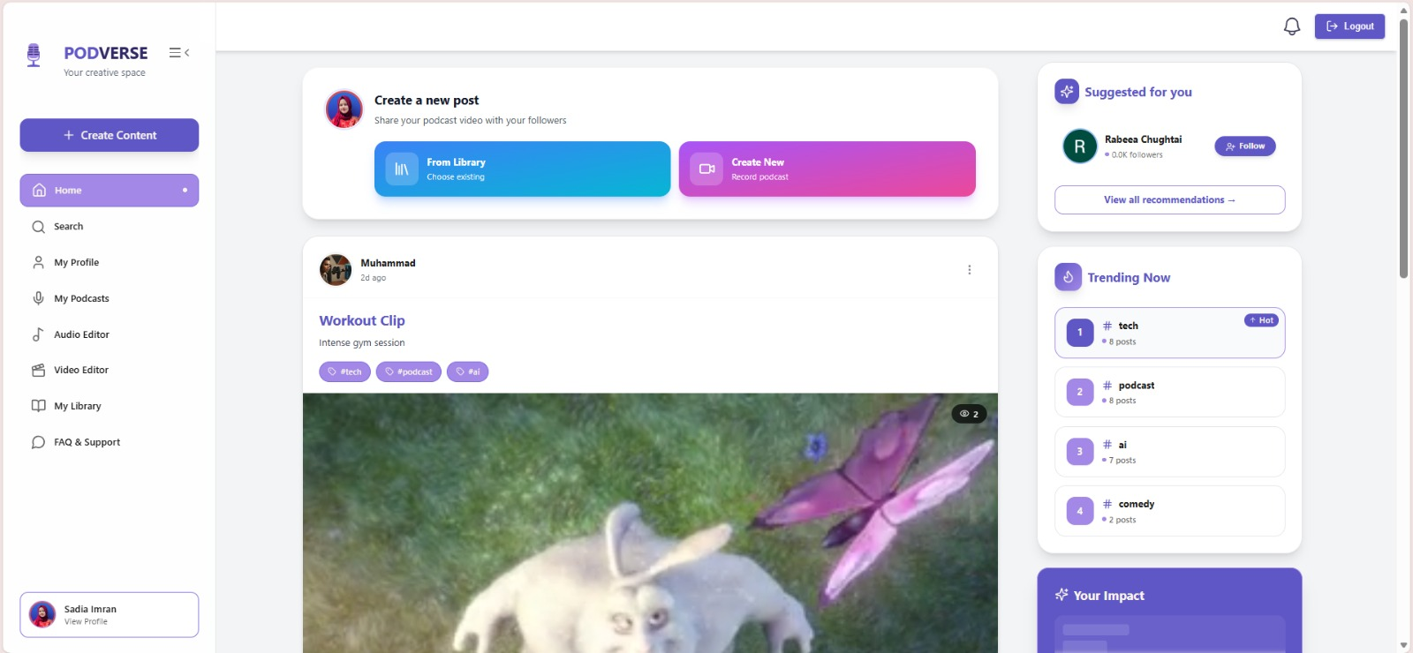
User Interface
/10
reallyygreatsite.com

Slide 11
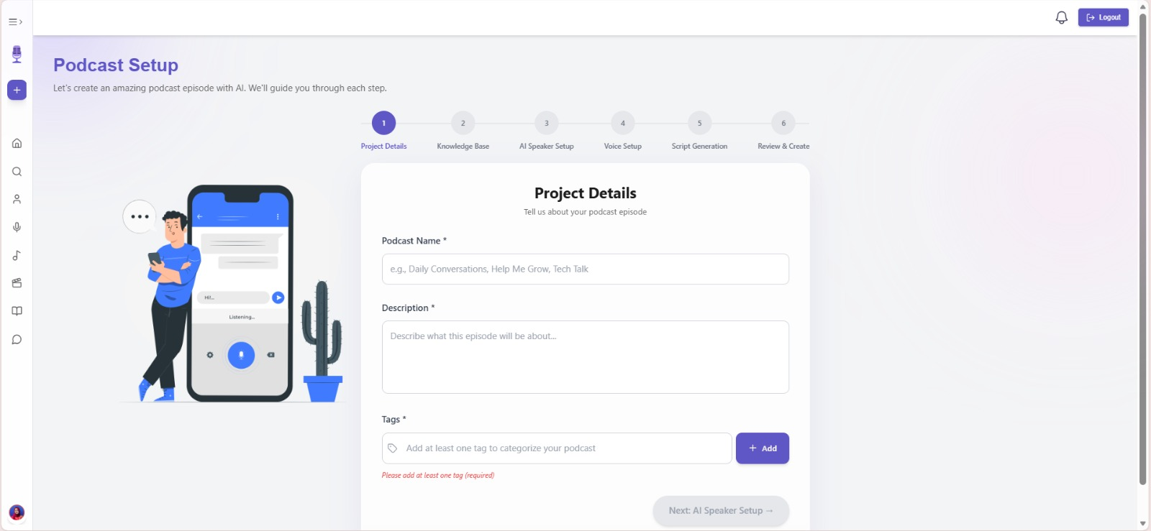
User Interface
/11
reallyygreatsite.com

Slide 12
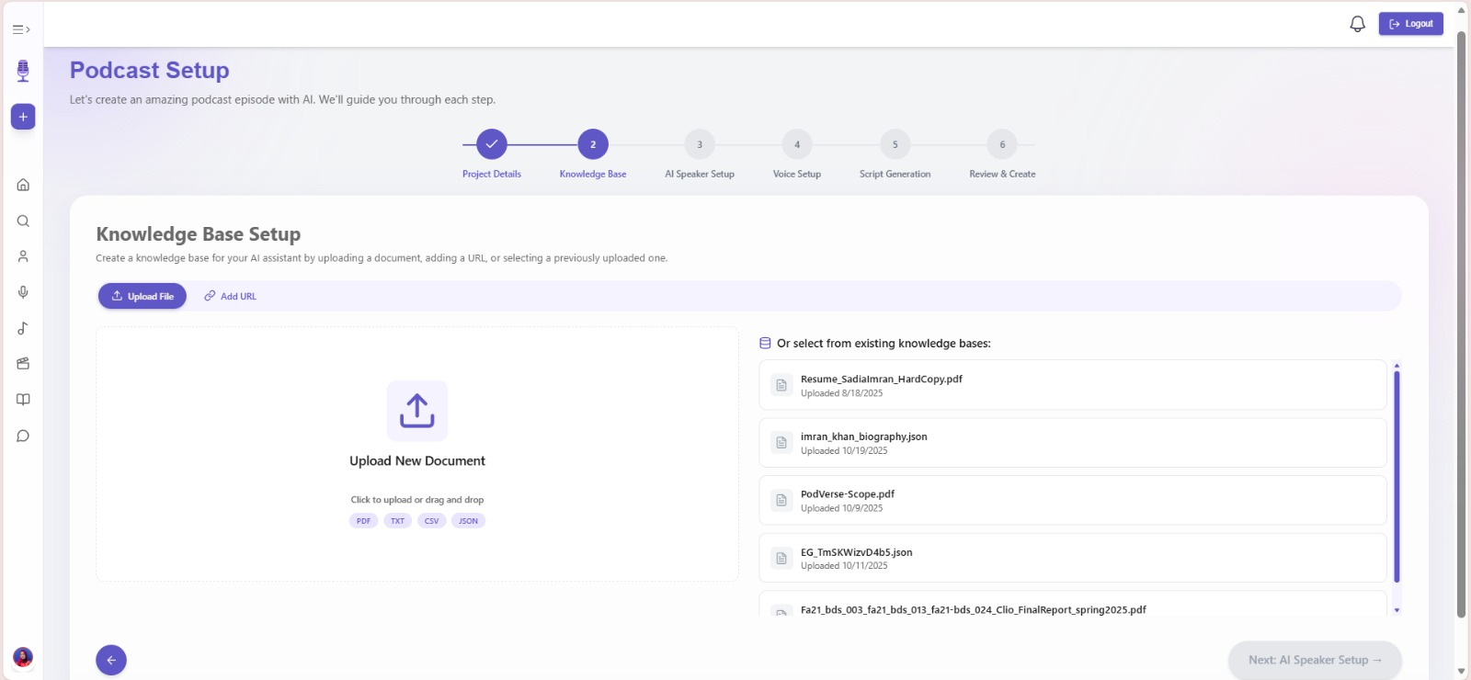
User Interface
/12
reallyygreatsite.com

Slide 13
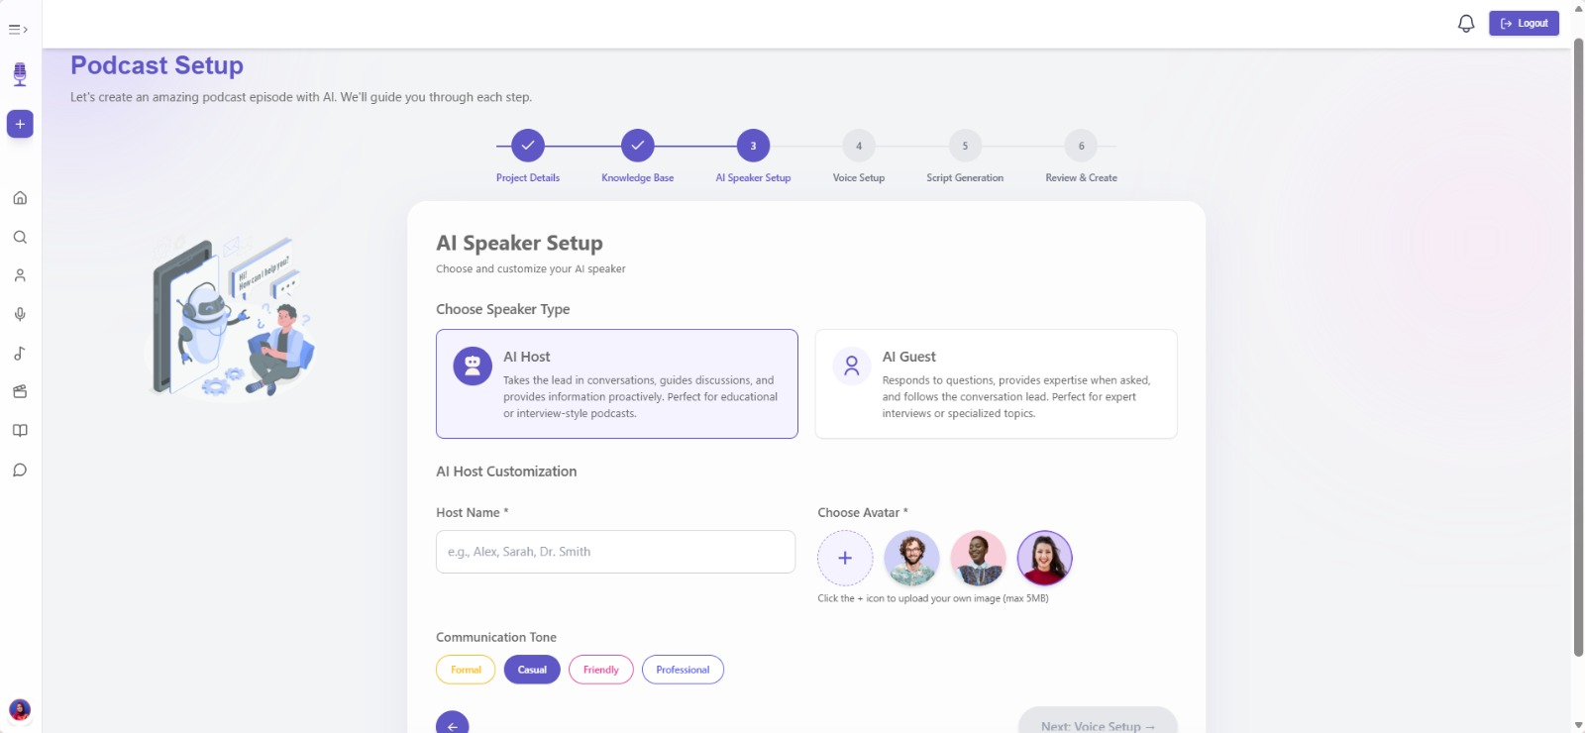
User Interface
/13
reallyygreatsite.com

Slide 14
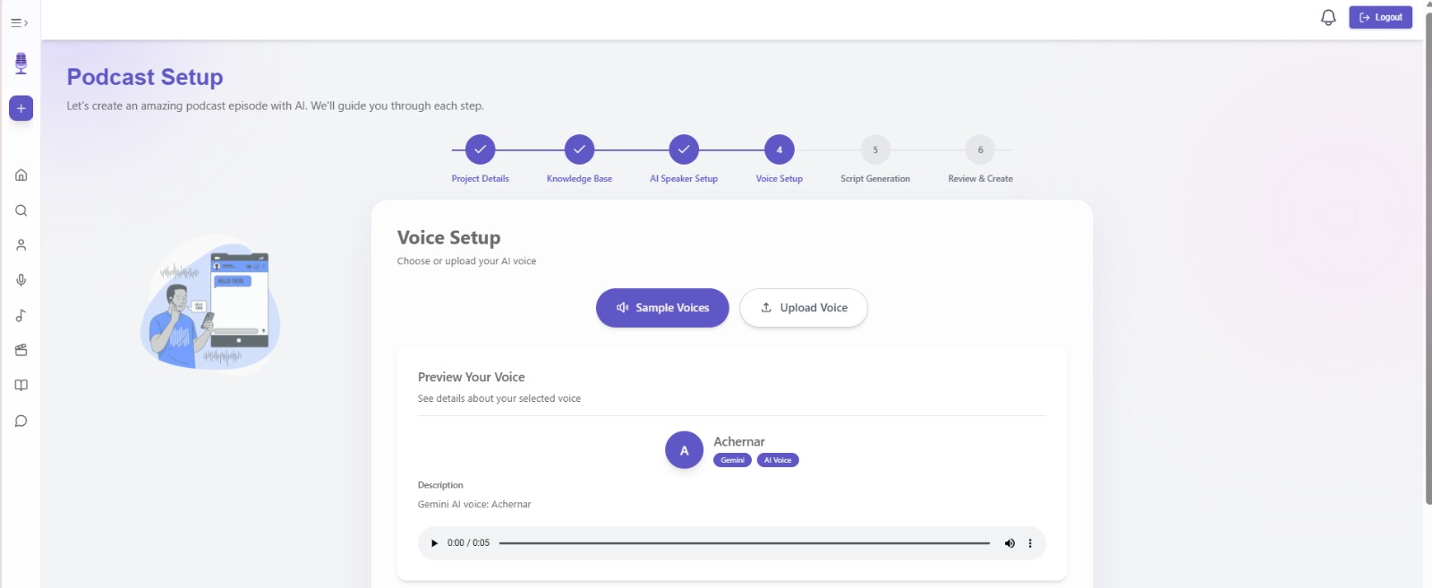
User Interface
/16
reallyygreatsite.com

Slide 15
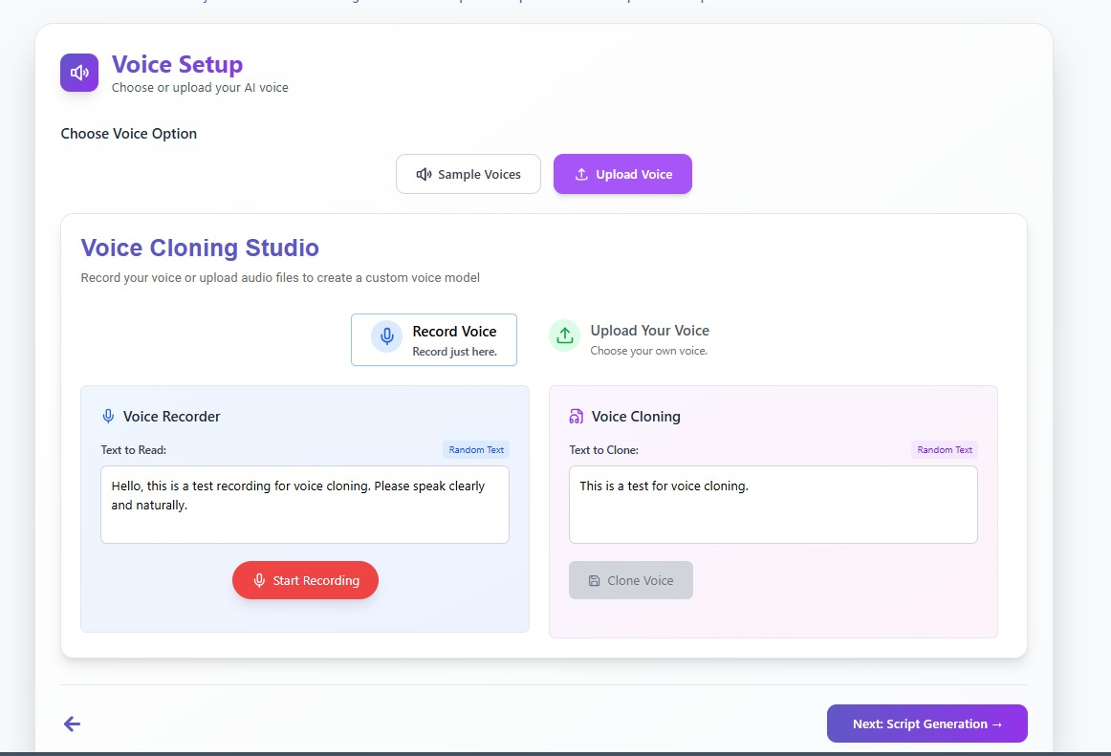
User Interface
/17
reallyygreatsite.com

Slide 16
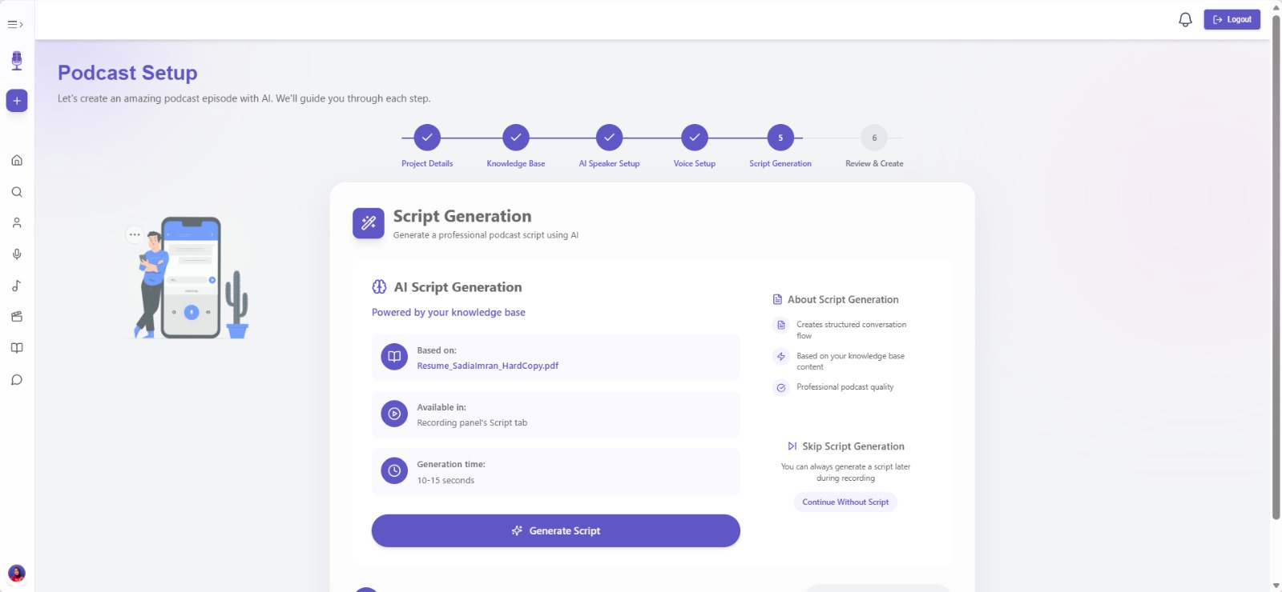
User Interface
/18
reallyygreatsite.com

Slide 17
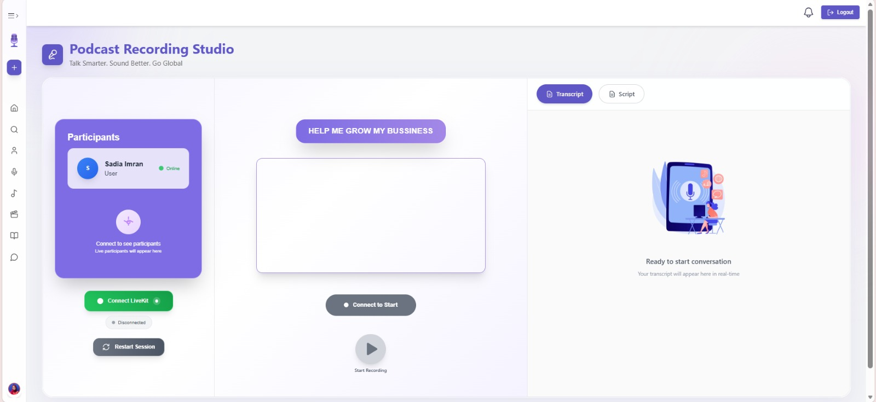
User Interface
/19
reallyygreatsite.com

Slide 18
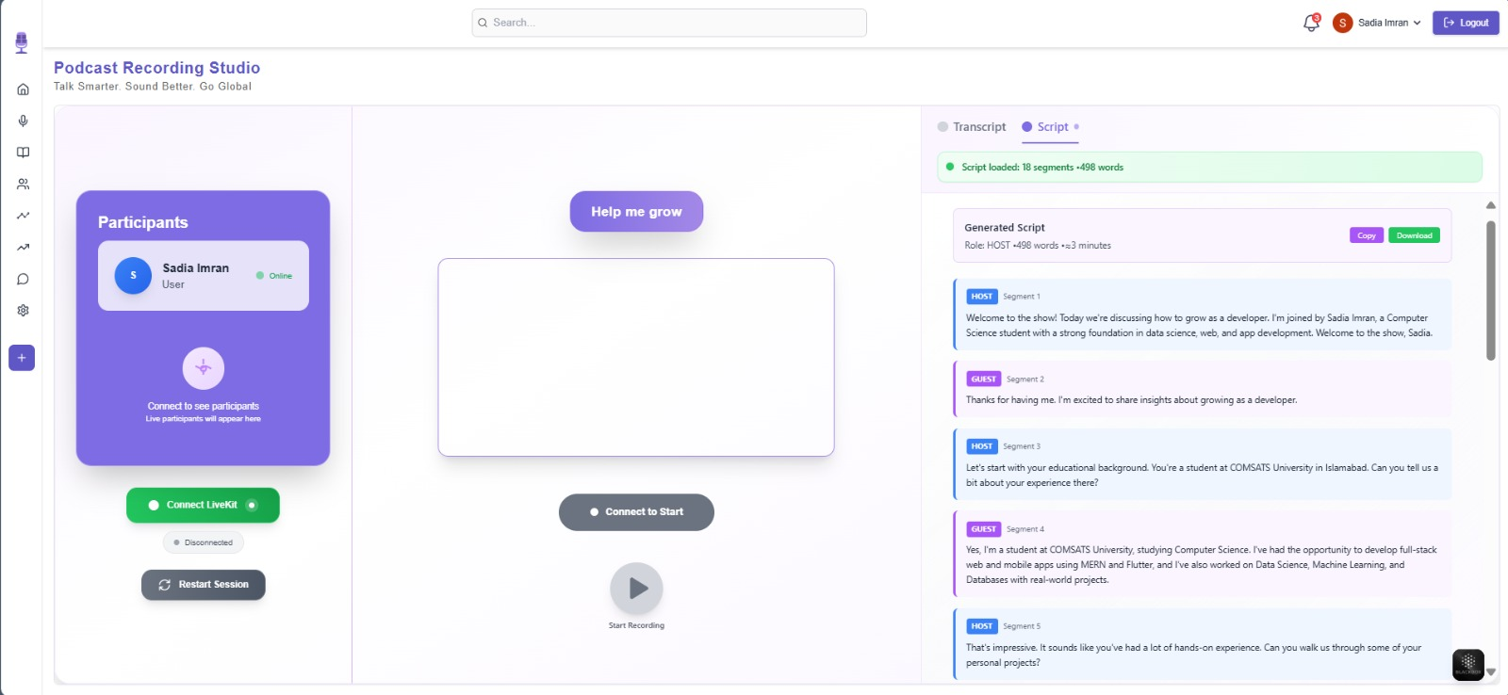
User Interface
/20
reallyygreatsite.com

Slide 19
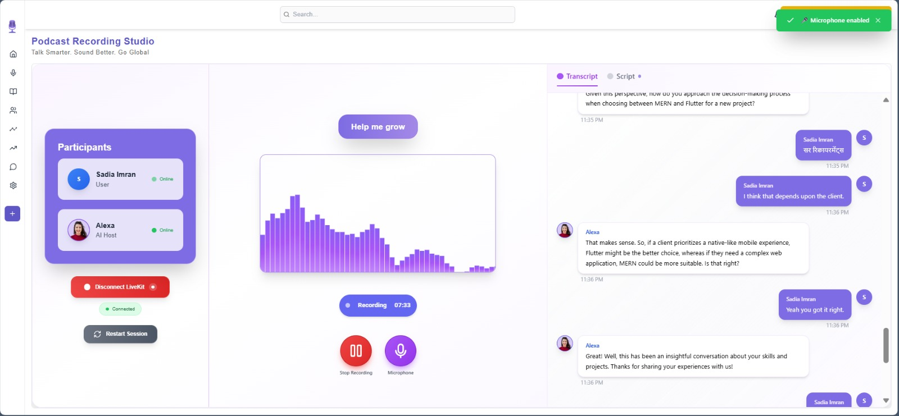
User Interface
/21
reallyygreatsite.com

Slide 20
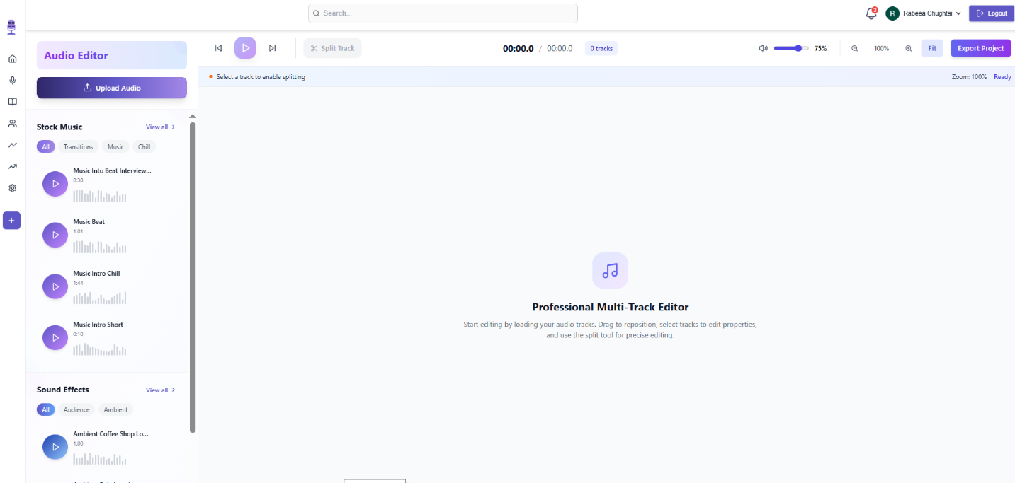
User Interface
/22
reallyygreatsite.com

Slide 21
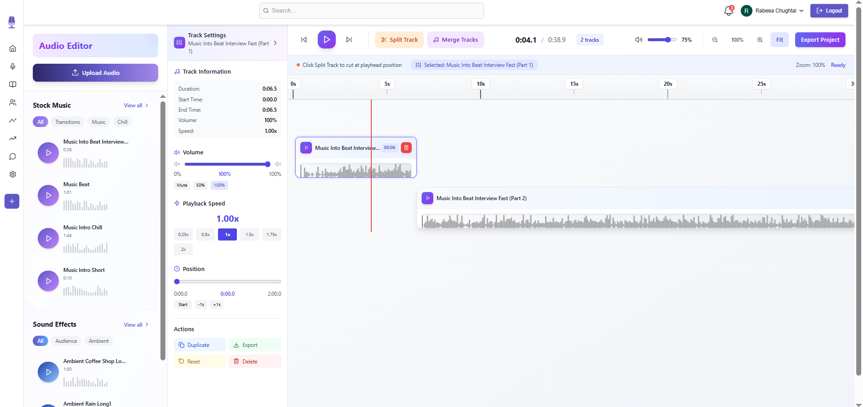
User Interface
/23
reallyygreatsite.com

Slide 22
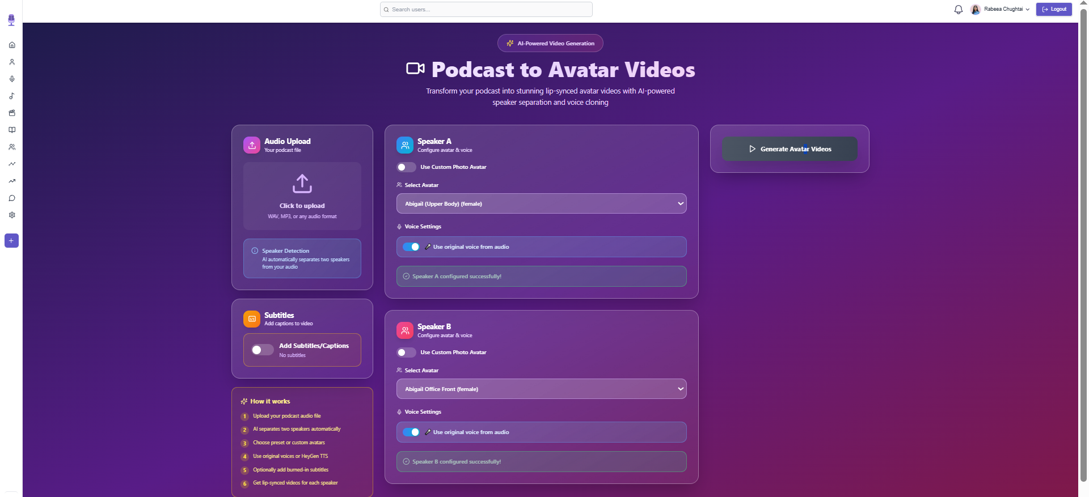
User Interface
/24
reallyygreatsite.com

Slide 23
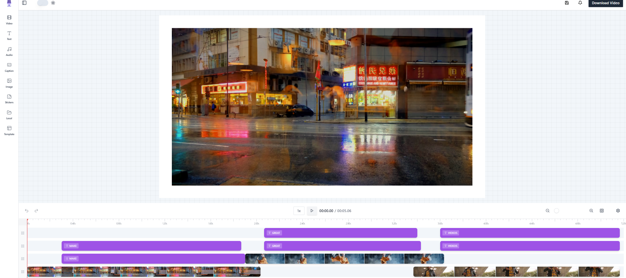
User Interface
/25
reallyygreatsite.com

Slide 24
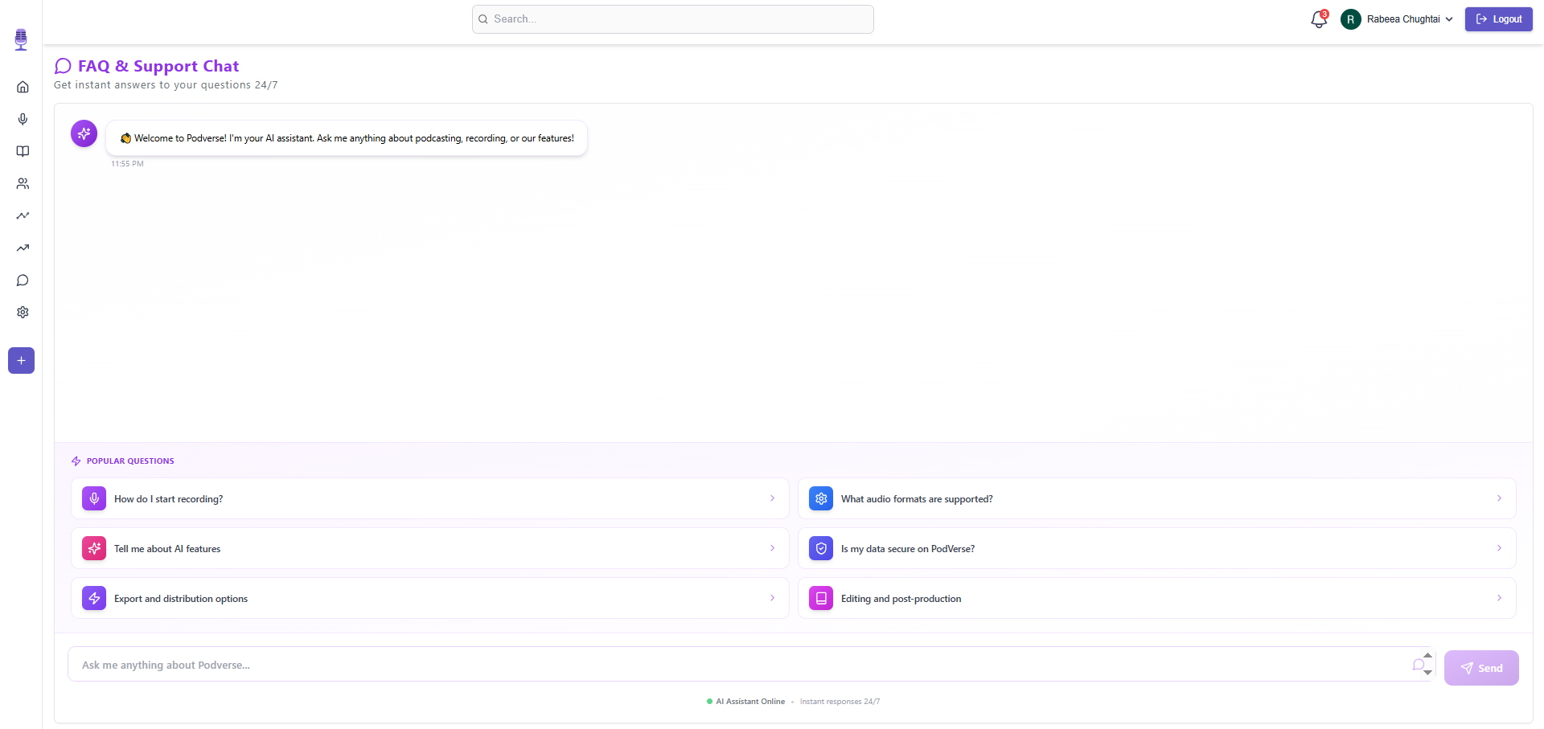
User Interface
/26
reallyygreatsite.com

Slide 25
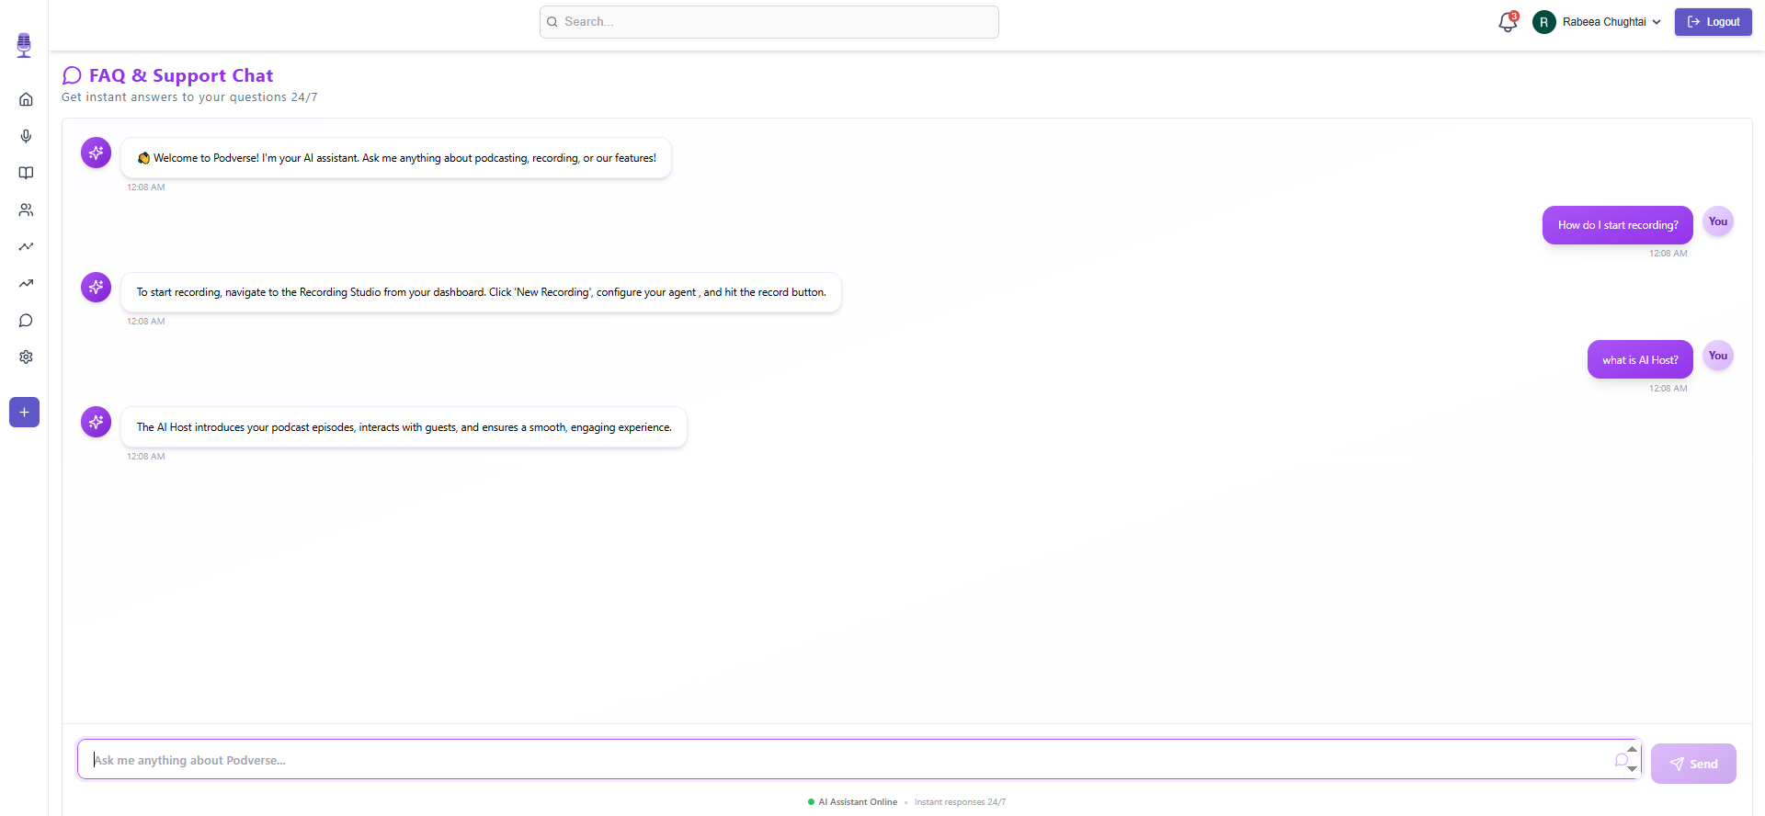
User Interface
/27
reallyygreatsite.com

Slide 26
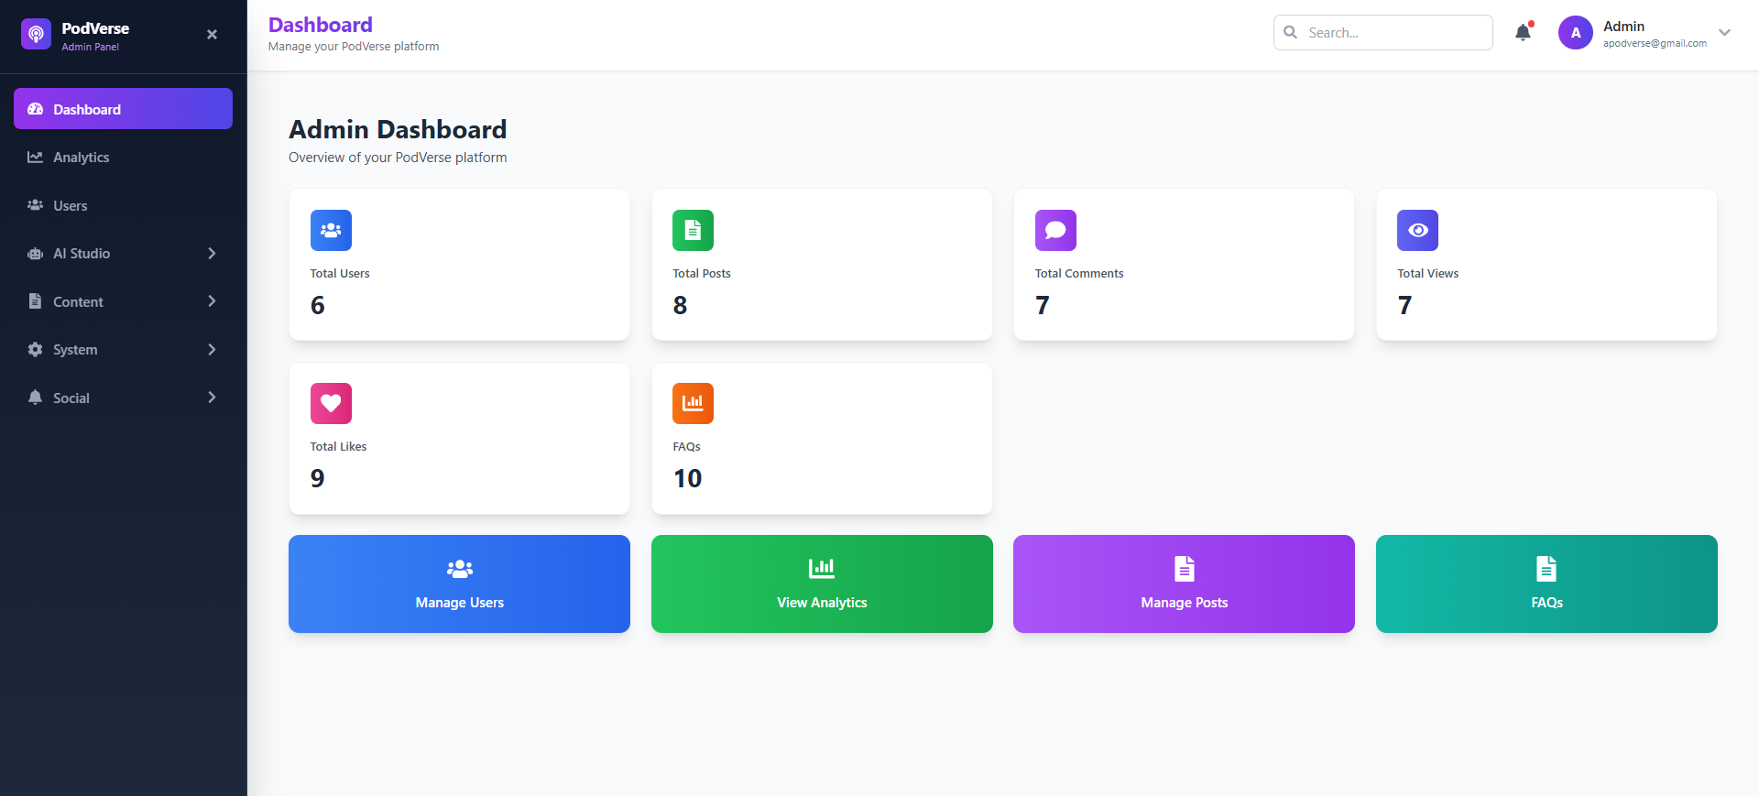
User Interface
/28
reallyygreatsite.com

Slide 27
/29
Thank You

